Slide 1
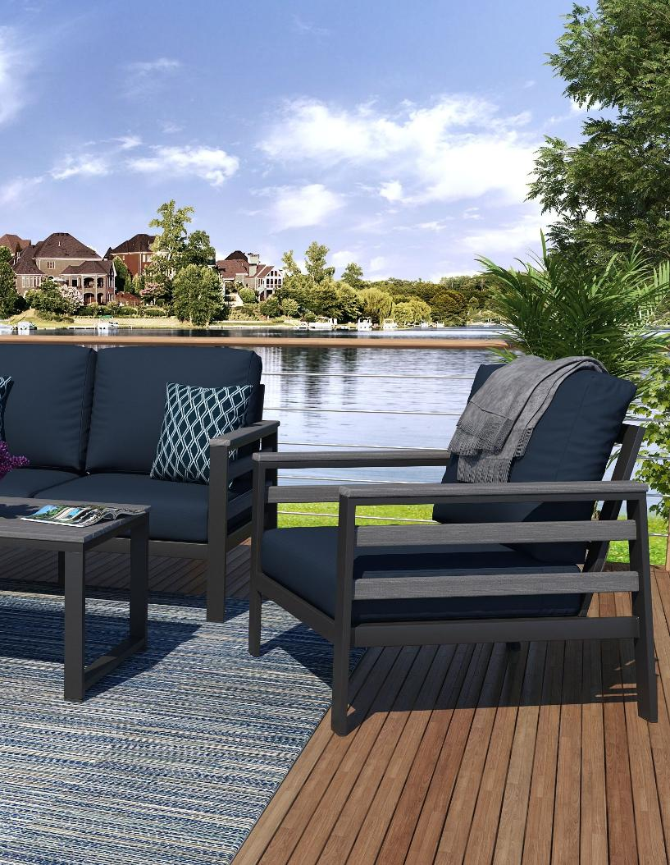


www.NorthCape.com
708-563-2890
2025 Product Catalog

Slide 2
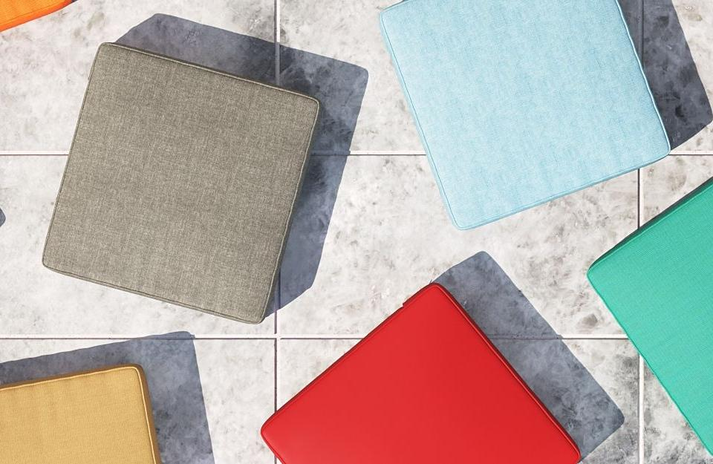

Slide 3
Contents
6400 / 6500 4-13
6400 Dining 14-15
2676 Nassau 16-17
2685 Chalfonte 18-21
Outdoor Upholstered
Woven
Fire Tables
Cushions
Furniture Covers
Warranty
2001 Tuscino 22-25
Mixed Media
6510 26-27
275 Bainbridge 28-29
6518 Edgewater 30-31
4331 Grand Stafford 32-33
4302 Lakeside 34-35
5306 Sydney 36-37
5319 38-39
Quick Ship 40
Custom 41
Fabrics 42-45
Dealer Program 46-57
Custom Covers 58
59-61

Slide 4
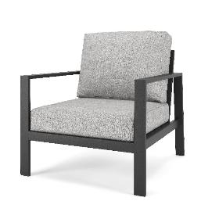
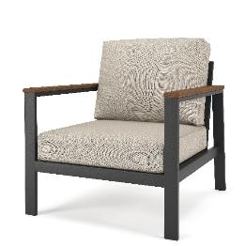
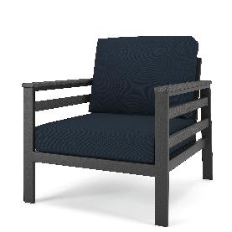
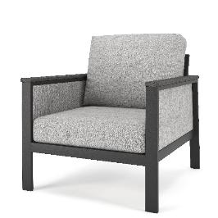
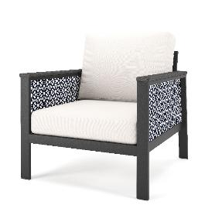
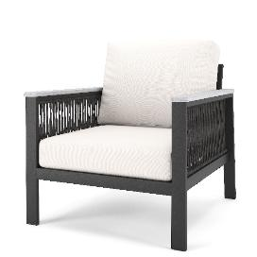
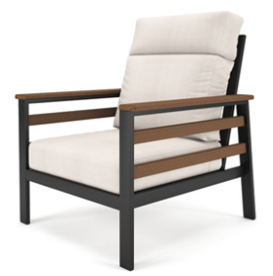
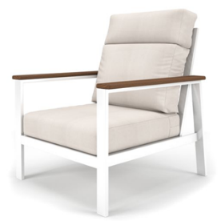

6400 Customize
DFM - MIXED MEDIA ALUMINUM
Bare
Tangent Arm
Tangent Arm Slats
Shown in Cast Breeze
Tangent Arm Fabric Panel
Tangent Arm Fabric Panel
Tangent Arm Rope Panel
High Back (6500) and White Options

Slide 5
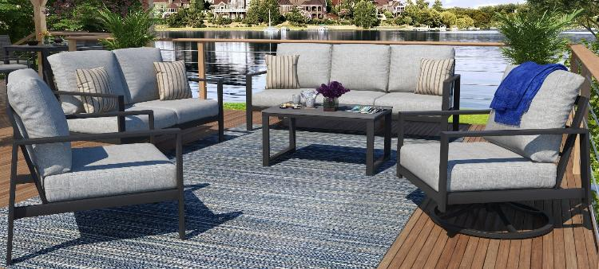
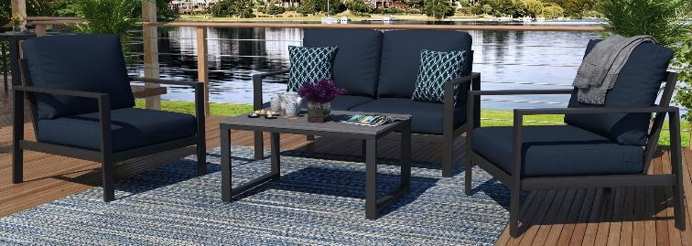
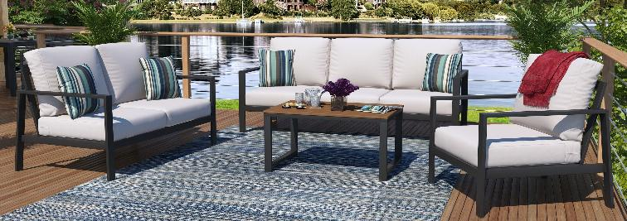
6400 Bare Arm
MIXED MEDIA ALUMINUM
Coastal Gray Table Tops Cast Silver Cushion
Shown in Cast Breeze
Coastal Gray Table Tops Canvas Navy Cushion
30
Antique Mahogany Table Tops Canvas Natural Cushion

Slide 6
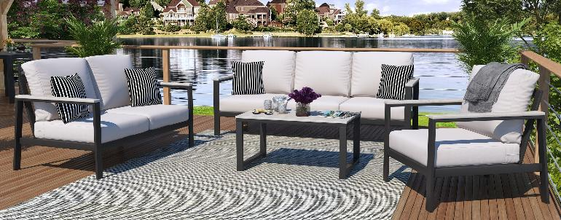
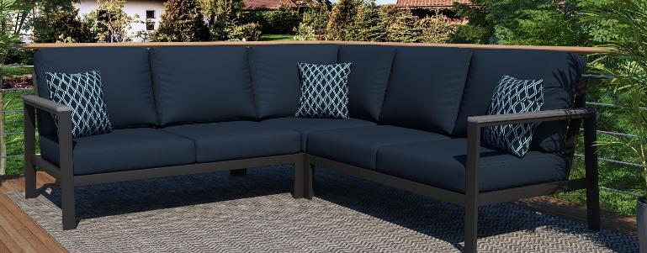
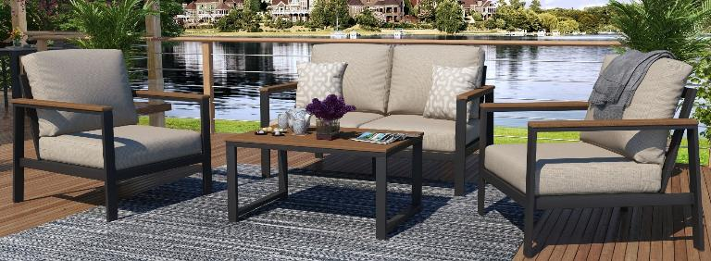
6400
Tangent Arm
MIXED MEDIA ALUMINUM
Seashell with Canvas Natural Cushion
Shown in Cast Breeze
Coastal Gray with Canvas Navy Cushion
30
Antique Mahogany with Canvas Granite Cushion

Slide 7
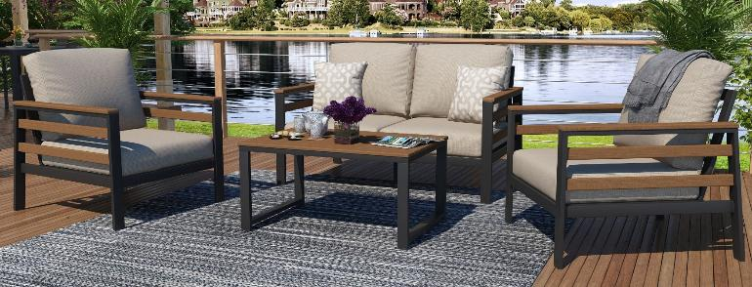
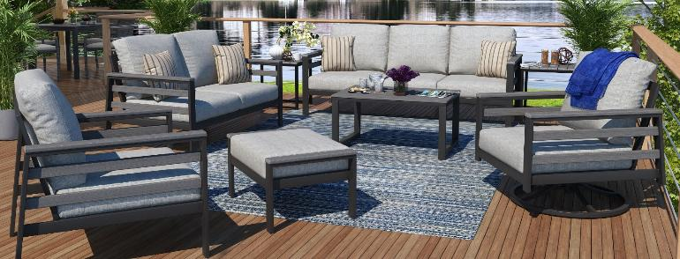
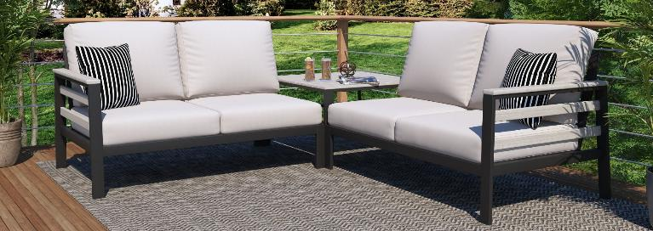
6400
Slat Panel
MIXED MEDIA ALUMINUM
Antique Mahogany with Canvas Granite Cushion
Shown in Cast Breeze
Coastal Gray with Cast Silver Cushion
30
Seashell with Canvas Natural Cushion

Slide 8
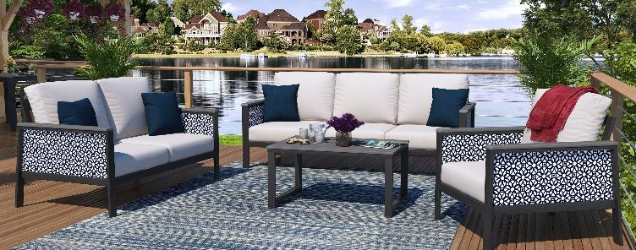
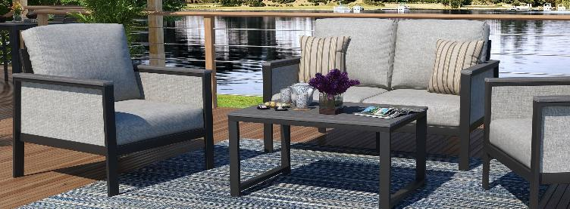
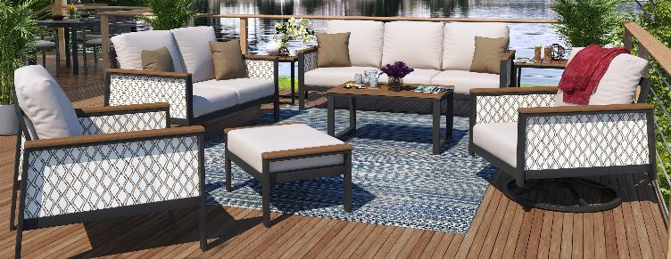
6400
Fabric Panel
MIXED MEDIA ALUMINUM
Coastal Gray with Luxe Indigo Panel and Canvas Natural Cushion
Shown in Cast Breeze
Coastal Gray with Cast Silver Panel and Cast Silver Cushion
30
Antique Mahogany with Voyage Dune Panel and Canvas Granite Cushion

Slide 9
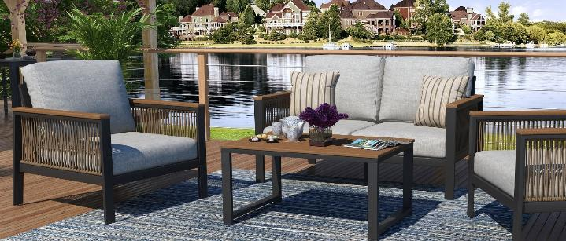
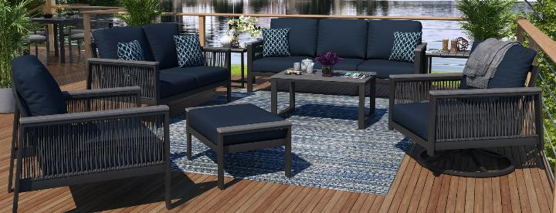
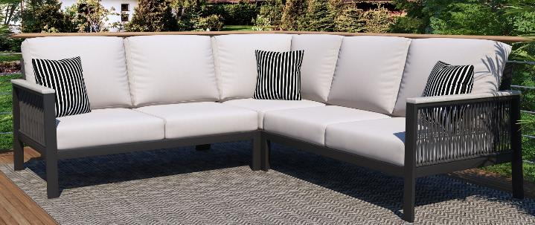
6400
Rope Panel
MIXED MEDIA ALUMINUM
Antique Mahogany with Brown Rope and Cast Silver Cushion
Shown in Cast Breeze
Coastal Gray with Gray Rope and Canvas Navy Cushion
30
Seashell with Gray Rope and Canvas Natural Cushion

Slide 10
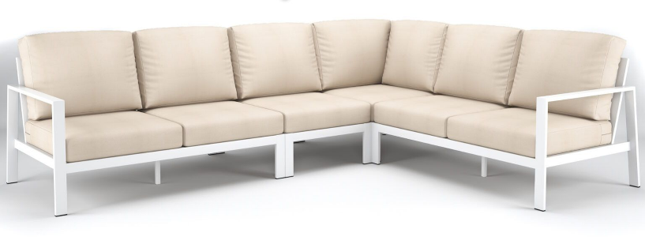
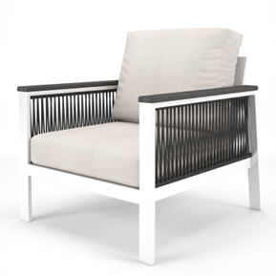
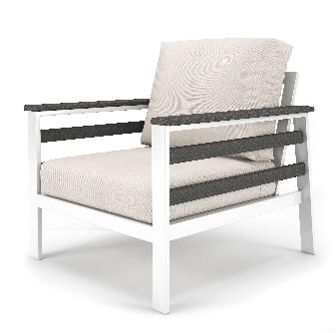

6400 White
6500 High Back Option

Slide 11

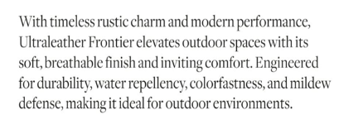
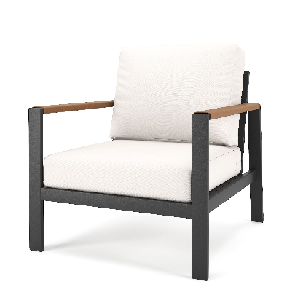
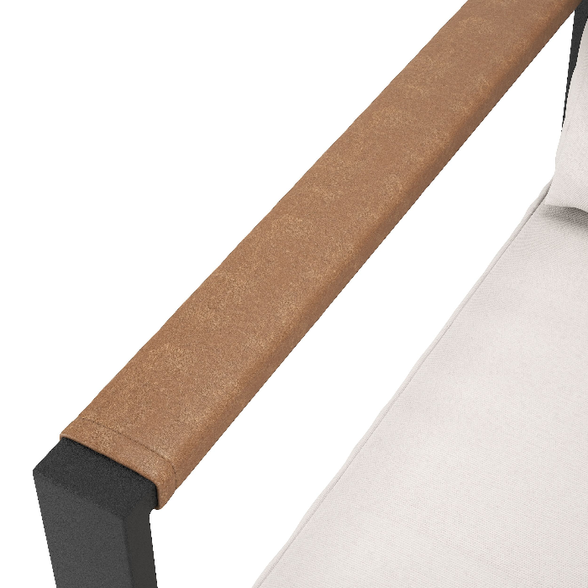
Ultra Leather

Slide 12
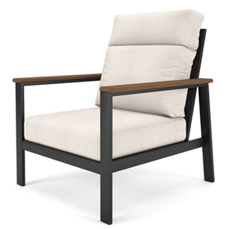
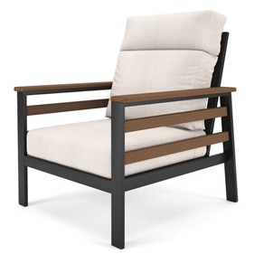
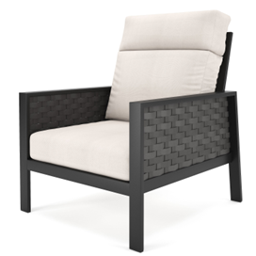
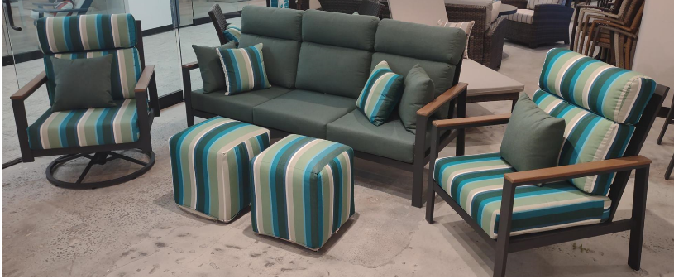
High Back 6500

Slide 13





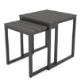

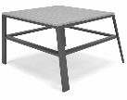



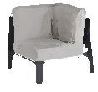
6400 Deep Seating
3 Seater Sofa NC64003S-TAN
Size: 80.3” x 33” x 28.7” ht.
Seat Size: 75” x 25” Cush270/271-3S: 6 pc. Cushion, 6” th.
Loveseat NC6400LS-TAN
Size: 55.1” x 33” x 28.7” ht.
Seat Size: 50” x 25” Cush270/271-LS: 4 PC. cushion, 6” th.
Lounge Chair NC6400C-TAN
Size: 30” x 33” x 28.7” ht.
Seat Size: 25” x 25” Cush270/271-C: 2 pc. cushion, 6” th.
Swivel Rocker NC6400SR-TAN
Size: 30” x 33” x 28.7” ht.
Seat Size: 25” x 25” Cush270/271-C: 2 pc. cushion, 6” th.
Fits Furniture Cover: FC003
Fits Furniture Cover: FC002
Fits Furniture Cover: FC001
Fits Furniture Cover: FC001
Ottoman NC6400O-REC-TAN
Size: 29” x 20” x 15” ht. Cush270/271O-REC:
1 pc. cushion, 4” th.
Fits Furniture Cover: FC006
Slat Nesting Tables NC6400NET-TAN
Large: 18.9” x 18.9” x 21.6” ht.
Small: 16.5” x 16.5” x 19.6” ht.
Slat Coffee Table NC6400CT-TAN
Size: 35.4” x 23.6” x 17.7” ht
Sectional Corner End Table
NC6400CET-TAN
Size: 32.9” x 32.9” x 20”
Fits Furniture Cover: FC025
Sectional Middle Armless
NC6400SCM
Size: 25.2” x 32.8” x 28.7”
Seat Size: 50” x 25” Cush270/271-C:
2 pc. cushion, 6” th.
Fits Furniture Cover: FC053 (R), FC054 (L) FC141 (R), FC142 (L)
Sectional Left Arm Loveseat
NC6400LL-TAN
Size: 52.6” x 32.8” x 28.7”
Seat Size: 50” x 25” Cush270/271-LS:
4 pc. cushion, 6” th.
Fits Furniture Cover: FC053 (R), FC054 (L) FC141 (R), FC142 (L)
Sectional Right Arm Loveseat
NC6400RL-TAN
Size: 52.6” x 32.8” x 28.7”
Seat Size: 50” x 25” Cush270/271-LS:
4 pc. cushion, 6” th.
Fits Furniture Cover: FC053 (R), FC054 (L) FC141 (R), FC142 (L)
Sectional 90 Degree Corner
NC6400SCC-TAN
Size: 32.8” x 32.8” x 28.7”
Seat Size: 25” x 25” Cush270/271-SCC
3 pc. cushion, 6” th.
Fits Furniture Cover: FC053 (R), FC054 (L) FC141 (R), FC142 (L)

Slide 14
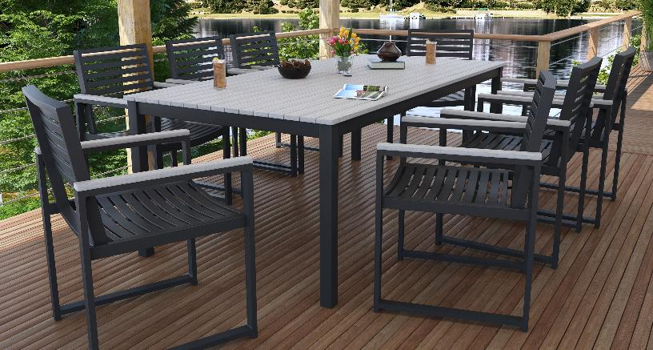
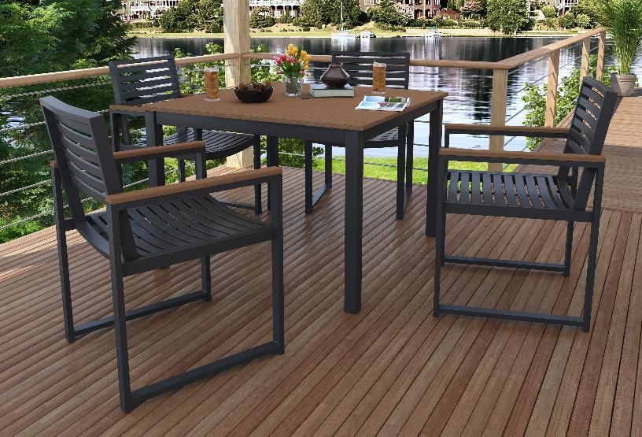
6400 Dining

Slide 15
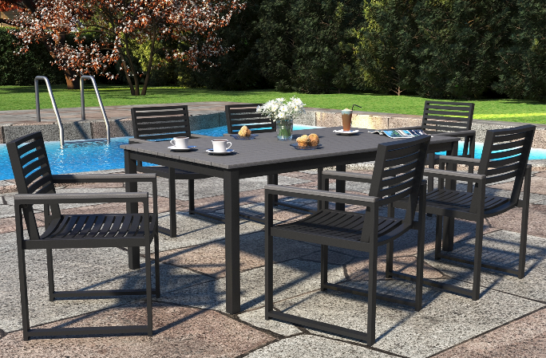


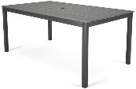
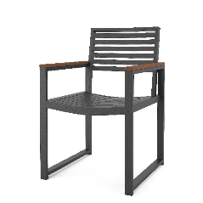
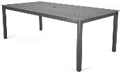
6400 Dining
MIXED MEDIA ALUMINUM
Shown in Cast Breeze
33” Square Dining Table | 41” Square Dining Table | 72” Rectangle Dining Table
* with Umbrella Hole | * with Umbrella Hole | * with Umbrella Hole
NC2685DT-TN-33 | NC2685DT-TN-41 | NC2685DT-TN-72
Size: 33” x 33” x 29” ht. | Size: 41” x 41” x 29” ht. | Size: 72” x 41” x 29” ht.
83” Rectangle Dining Table
* with Umbrella Hole
NC2685DT-TN-83
Size: 83” x 41” x 29” ht.
Dining Chair
C6400DC-TAN
Size: 26” x 22” x 34.6” ht. CUSH6400DC: 1 PC. CUSHION, 3” TH.

Slide 16
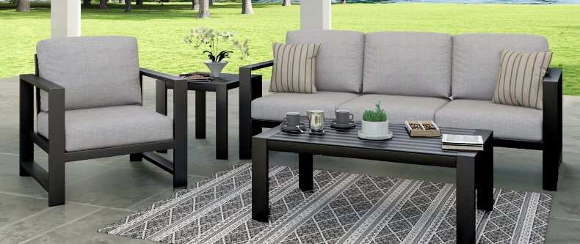
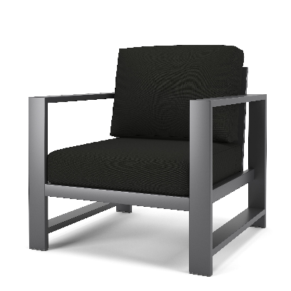
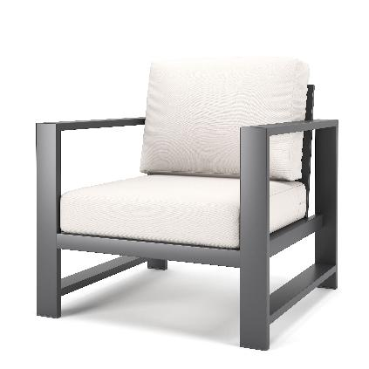
2676 Nassau

Slide 17
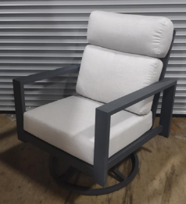
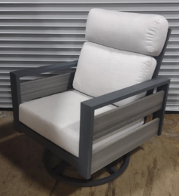
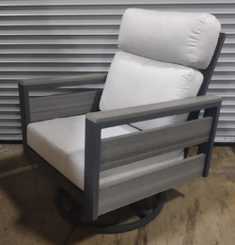

2676 Nassau
High Back and Tangent Options

Slide 18




CHALFONTE
SEATING NC2685
MIXED MEDIA ALUMINUM
Canvas Canvas
Husk Double Flat
Dark Gray Aluminum
Canvas Canvas

Slide 19














CHALFONTE Deep Seating
Club Chair NC2685CAA Size: 31” x 32.5” x 33” ht. Seat Size: 25” x 25” Deck Ht: 13” Cush270/271-C: 2 pc. cushion, 6” th. | Swivel Glider Chair NC2685SGAA Size: 31” x 32.5” x 33” ht. Seat Size: 25” x 25” Deck Ht: 13” Cush270/271-C: 2 pc. cushion, 6” th. | Loveseat NC2685LSAA Size: 56” x 32.5” x 33” ht. Seat Size: 50” x 25” Deck Ht: 13” Cush270/271-LS: 4 pc. cushion, 6” th. | Sofa NC26853SAA Size: 81” x 32.5” x 33” ht. Seat Size: 75” x 25” Deck Ht: 13” Cush270/271-3S: 6 pc. cushion, 6” th.
Fits Furniture Cover: FC001 | Fits Furniture Cover: FC001 | Fits Furniture Cover: FC002 | Fits Furniture Cover: FC003
Sectional 90 Degree Corner NC2685SCC Size: 32.5” x 32.5” x 33” ht. Seat Size: 25” x 25” Deck Ht: 13” Cush270/271-SCC: 3 pc. cushion, 6” th. | Sectional Middle Chair NC2685SCM Size: 25” x 32.5” x 33” ht. Seat Size: 25” x 25” Deck Ht: 13” Cush270/271-C: 2 pc. cushion, 6” th. | Sectional Left Arm Loveseat NC2685LLAA Size: 53” x 32.5” x 33” ht. Seat Size: 50” x 25” Deck Ht: 13” Cush270/271 -LS: 4 pc. cushion, 6” th. | Sectional Right Arm Loveseat NC2685RLAA Size: 53” x 32.5” x 33” ht. Seat Size: 50” x 25” Deck Ht: 13” Cush270/271-LS: 4 pc. cushion, 6” th.
Fits Furniture Cover: FC053 (R), FC054 (L) | Fits Furniture Cover: FC053 (R), FC054 (L) FC141 (R), FC142 (L) | Fits Furniture Cover: FC053 (R), FC054 (L) FC141 (R), FC142 (L) | Fits Furniture Cover: FC053 (R), FC054 (L) FC141 (R), FC142 (L)
Sectional Left Arm Sofa NC2685L3SAA Size: 78” x 32.5” x 33” ht. Seat Size: 75” x 25” Deck Ht: 13” Cush270/271-3S: 6 pc. cushion, 6” th. | Sectional Right Arm Sofa NC2685R3SAA Size: 78” x 32.5” x 33” ht. Seat Size: 75” x 25” Deck Ht: 13” Cush270/271-3S: 6 pc. cushion, 6” th. | Ottoman NC6400O-REC Size: 29” x 20” x 15” ht. Cush270/271O-REC: 1 pc. cushion, 4” th. Fits Furniture Cover: FC006 | Slat Coffee Table NC6400CT-(DB or TAN) Size: 35.4” x 23.6” x 17.7” ht
Fits Furniture Cover: FC003 | Fits Furniture Cover: FC003
Slat Nesting Tables NC6400NET-(DB or TAN) Large: 18.9” x 18.9” x 21.6” ht. Small: 16.5” x 16.5” x 19.6” ht. Fits Furniture Cover: FC025
End Table NC6400ET-(DB or TAN)
Large: 18.9” x 18.9” x 21.6” ht.
Fits Furniture Cover: FC025
Slat Coffee Table NC6400LCT-(DB or TAN)
Size: 42” x 25” x 17.7” ht
Corner End Table/ Square Coffee Table NC6400CET-(DB or TAN)
Size: 31” x 31” x 21” ht

Slide 20





CHALFONTE
Dining NC2685
MIXED MEDIA ALUMINUM
Gray Duraboard
Dark Gray Aluminum
Resin Weave
Husk Double Flat
Duraboard Top Tables
Thick-gauged, powder-coated aluminum frame offers long lasting durability and rust resistance.
Duraboard® table top – treated with a UV-coating process which makes it highly resistant to scratches and weather conditions.
Built to last a lifetime, Duraboard® – an innovative material for outdoor table tops like no other on the market – is an environmentally friendly material that is durable, highly UV-resistant and has a unique surface finish. It features two main components, eucalyptus FSC™ sawdust and polyethylene resin, extruded to create a strong, durable structure. The table top is treated with a
UV-coating process, receiving a multi-layer coating which makes it highly resistant to scratches and weather conditions.

Slide 21










CHALFONTE - DINING
NC2685
33” Square Dining Table | 41” Square Dining Table | 72” Rectangle Dining Table
* with Umbrella Hole | * with Umbrella Hole | * with Umbrella Hole
NC2685DT33-SQ-DRB-DH | NC2685DT41-SQ-DRB-DH | NC2685DT72-REC-DRB-DH
Size: 33” x 33” x 29” ht. | Size: 41” x 41” x 29” ht. | Size: 72” x 41” x 29” ht.
83” Rectangle Dining Table | 33” Square Counter Height Table | 41” Square Counter Height Table
* with Umbrella Hole | * with Umbrella Hole | * with Umbrella Hole
NC2685DT83-REC-DRB-DH | NC2685CH33-SQ-DRB | NC2685CH41-SQ-DRB
Size: 83” x 41” x 29” ht. | Size: 33” x 33” x 38” ht. | Size: 41” x 41” x 38” ht.
72” Rectangle Counter Height Table * with Umbrella Hole NC2685CH72-REC-DRB | Dining Chair - Stackable NC2685DC Size: 23.5” x 24” x 36” ht. | Swivel Rocker Dining Chair NC2685SWDC Size: 23.5” x 24” x 36” ht.
Size: 72” x 33” x 38” ht.
Counter Height Stool w/Arms | Dining Loveseat Bench w Duraboard Seat
NC2685BS-CH | NC2685DLS
Size: 24” x 23.5” x 43.5” ht. | Size: 63” x 14” x 17” ht.
Seat Height: 25.5”
Arm Height: 33”
Single Adjustable Chaise Lounge
NC2685SACL
Size: 78.5” x 29.75” x 15” ht.

Slide 22




TUSCINO
NC2001
MIXED MEDIA
Canvas Natural
Shown in Canvas Natural
Shown in Canvas Granite
Shore Classic
Shown in Spectrum Indigo
Canvas Navy and Escape Denim

Slide 23




Slide 24





Tuscino Cubes
Available in 3 Sizes
Tuscino Dining Chair and Bench

Slide 25









TUSCINO
NC2001
Modular Armless Middle Chair NC2001SCM Size: 36” x 30” x 32” ht. Seat Size: 24” x 30”, Deck Ht: 18” Fits Furniture Cover: FC001 | Modular Corner NC2001SCC Size: 36” x 36” x 32” ht. Seat Size: 24” x 24”, Deck Ht: 18” Fits Furniture Cover: FC139
Square Ottoman NC2001OT-SQ Size: 30” x 30” x 18” ht. Fits Furniture Cover: FC024 | Cube Ottoman Medium NC2001CUB-MED Size: 22” x 22” x 18” ht.
Cube Ottoman Small NC2001CUBE-SM Size: 18” x 18” x 18” ht. | Slat Nesting Tables NC6400NET-TAN Large: 18.9” x 18.9” x 21.6” ht. Small: 16.5” x 16.5” x 19.6” ht. Fits Furniture Cover: FC025
Slat Coffee Table NC6400CT-TAN Size: 35.4” x 23.6” x 17.7” ht
Recycled Tangent Frame
Removable Fabric Cover
Crowned to naturally repel water
Dacron and Foam Core
Suspension Seat for added comfort

Slide 26





WOVEN
6510
NC6510
Linen Canvas
Parchment
Cast Ash
1

Slide 27








WOVEN
6510
NC6510
3-Seater Sofa NC65103S Size: 74” x 29” x 31” ht. Seat Size: 66” x 23”, Deck ht: 12.5” CUSH6510-3S: 6 pc. cushion, 4.5” thick, no welt, 2 buttons per seat back Fits Furniture Cover: FC098 | Loveseat NC6510LS Size: 52” x 29” x 31” ht. Seat Size: 44” x 23” , Deck ht: 12.5” CUSH6510 -LS: 4 pc. cushion, 4.5” thick, no welt, 2 buttons per seat back Fits Furniture Cover: FC097
Lounge Chair NC6510C Size: 30” x 29” x 31” ht. Seat Size: 22” x 23”, Deck ht: 12.5” CUSH6510-C: 2 pc. cushion, 4.5” thick, no welt, 2 buttons per seat back Fits Furniture Cover: FC096 | Swivel Rocker NC6510SR Size: 30” x 29” x 31” ht. Seat Size: 22” x 23”, Deck ht: 12.5” CUSH6510-C: 2 pc. cushion, 4.5” thick, no welt, 2 buttons per seat back Fits Furniture Cover: FC096
Ottoman NC6510O-REC Size: 31” x 20” x 18” ht. Seat Size: 22” x 20”, Deck ht: 12.5” CUSH600-O-REC: 1 pc. cushion, 4.5” thick, no welt | Rotating Chat Table NC6510R-CHT Size: 36”dia. x 20” ht. Rotating Chat Table Glass NC6510R-CHT-GL • 36”dia. x ¼” ht.
Fits Furniture Cover: FC006
Square End Table NC6510ET-SQ: 22” x 22” x 22” ht. | Rectangular Coffee Table NC6510CT-REC: 34” x 24” x 17.5” ht.
Square End Table Glass NC6510ET-SQ-GL: 22” x 22” x ¼” ht. | Rectangular Coffee Table Glass NC6510CT-REC-GL: 34” x 24” x ¼” ht.
Fits Furniture Cover: FC025 | Fits Furniture Cover: FC102

Slide 28




BAINBRIDGE
NC275
WOVEN
Canvas Natural
Spectrum Indigo
Canvas Natural
Willow Thick

Slide 29
















BAINBRIDGE
NC275
Coordinating Universal Pieces are also available.
3 Seater Sofa NC2753S Size: 81” x 32.5” x 33” ht. Seat Size: 75” x 25”, Deck Ht: 13” Cush270/271-3S: 6 pc. cushion, 6” th. Fits Furniture Cover: FC003 | Loveseat NC275LS Size: 56” x 32.5” x 33” ht. Seat Size: 50” x 25”, Deck Ht: 13” Cush270/271-LS: 4 pc. cushion, 6” th. Fits Furniture Cover: FC002 | Club Chair NC275C Size: 31” x 32.5” x 33” ht. Seat Size: 25” x 25”, Deck Ht: 13” Cush270/271-C: 2 pc. cushion, 6” th. Fits Furniture Cover: FC001 | Swivel Glider Club Chair NC275SG Size: 31” x 32.5” x 33” ht. Seat Size: 25” x 25”, Deck Ht: 13” Cush270/271-C: 2 pc. cushion, 6” th. Fits Furniture Cover: FC001
Universal High Back Swivel Glider NC415HBSG-P Size: 30” X 33” X 39”ht. Seat Size: 24.5” X 26”, Deck ht: 13” Cush4312/4313-C: : 2 pc. cushion, 6” th. | Sectional Left Arm Loveseat NC275LL Size: 53” x 32.5” x 33” ht. Seat Size: 50” x 25”, Deck Ht: 13” Cush270/271 -LS: 4 pc. cushion, 6” th. | Sectional Right Arm Loveseat NC275RL Size: 53” x 32.5” x 33” ht. Seat Size: 50” x 25”, Deck Ht: 13” Cush270/271-LS: 4 pc. cushion, 6” th. | Sectional Corner Chair NC275SCC Size: 32.5” x 32.5” x 33” ht. Seat Size: 25” x 25”, Deck Ht: 13” Cush270/271-SCC: 3 pc. cushion, 6” th.
Fits Furniture Cover: FC081 | Fits Furniture Cover: FC053 (R), FC054 (L) FC141 (R), FC142 (L) | Fits Furniture Cover: FC053 (R), FC054 (L) FC141 (R), FC142 (L) | Fits Furniture Cover: FC053 (R), FC054 (L)
45° Sectional Corner NC275SCC-45 Size: 62.5” x 33.5” x 33” ht. Seat Size: 57.5” x 32”, Deck Ht: 13” Cush270/271SCC-45: 3 pc. cushion, 6” th. | Sectional Middle Chair NC275SCM Size: 25” x 32.5” x 33” ht. Seat Size: 25” x 25”, Deck Ht: 13” Cush270/271-C: 2 pc. cushion, 6” th. | Rectangular Ottoman NC275O-REC Size: 29.5” x 20” x 16.5” ht. Seat Size: 24” x 20”, Deck Ht: 13” Cush270/271O-REC: 1 pc. cushion, 4” th. | Square Ottoman NC275O-SQ Size: 25” x 25” x 13” ht. Seat: 25” x 25”, Deck Ht: 13” Cush270/271O-SQ: 1 pc. cushion, 6”th.
Fits Furniture Cover: FC141 (R), FC142 (L) | Fits Furniture Cover: FC053 (R), FC054 (L) FC141 (R), FC142 (L) | Fits Furniture Cover: FC006 | Fits Furniture Cover: FC041
Recliner Standard Weave: NC415RX Premium Weave: NC415RX-P Size: 31” X 33” X 39”ht. | End Table NC275ET-SQ Size: 20” x 20” x 21” ht. End Table Glass NC275ET-SQ-GL Size: 20” x 20” x ¼” ht. | Square Coffee Table NC275CT-SQ Size: 32” x 32” x 17” ht. Coffee Table Glass NC275CT-SQ-GL: 32” x 32” x ¼” ht. | Rectangular Coffee Table NC275CT-REC Size: 44”Wx 28” x 17”ht. Rectangular Coffee Table Glass NC275CT-REC-GL Size: 44” x 28” x ¼” ht.
Cush4312/4313-C: 2 pc. cushion, 6” th.
Fits Furniture Cover: FC081 | Fits Furniture Cover: FC045 | Fits Furniture Cover: FC044 | Fits Furniture Cover: FC140

Slide 30




EDGEWATER
NC6518
WOVEN
Cast Ash
Shown Canvas Natural
Linen Canvas
Husk

Slide 31








EDGEWATER
NC6518
Coordinating Universal Pieces are also available.
3 Seater Sofa NC65183S Size: 74” x 29” x 31” ht. Seat Size: 66” x 23”, Deck ht: 12.5” CUSH6510-3S: 6 pc. cushion, 4.5” thick, no welt, 2 buttons per seat back Fits Furniture Cover: FC098 | Loveseat NC6518LS Size: 52” x 29” x 31” ht. Seat Size: 44” x 23” , Deck ht: 12.5” CUSH6510 -LS: 4 pc. cushion, 4.5” thick, no welt, 2 buttons per seat back Fits Furniture Cover: FC097
Lounge Chair NC6518C Size: 30” x 29” x 31” ht. Seat Size: 22” x 23”, Deck ht: 12.5” CUSH6510-C: 2 pc. cushion, 4.5” thick, no welt, 2 buttons per seat back Fits Furniture Cover: FC096 | Swivel Rocker NC6518SR Size: 30” x 29” x 31” ht. Seat Size: 22” x 23”, Deck ht: 12.5” CUSH6510-C: 2 pc. cushion, 4.5” thick, no welt, 2 buttons per seat back Fits Furniture Cover: FC096
Rectangular Ottoman NC6518O-REC Size: 31” x 20” x 18” ht. Seat Size: 22” x 20”, Deck ht: 12.5” CUSH600O-REC: 1 pc. cushion, 4.5” thick, no welt Fits Furniture Cover: FC006 | Rotating Chat Table NC6518R-CHT Size: 36”dia. x 20” ht. Rotating Chat Table Glass NC6518R-CHT-GL • 36”dia. x ¼” ht.
Square End Table NC6518ET-SQ: 22” x 22” x 22” ht. Square End Table Glass Top NC6518ET-SQ-GL: 22” x 22” x ¼” ht. Fits Furniture Cover: FC025 | Rectangular Coffee Table NC6518CT-REC: 34” x 24” x 17.5” ht. Rectangular Coffee Table Glass Top NC6518CT-REC-GL: 34” x 24” x ¼” ht. Fits Furniture Cover: FC102

Slide 32


GRAND STAFFORD
NC4331
WOVEN
Canvas Canvas
Cast Ash
Husk

Slide 33








Coordinating Universal Pieces are also available. GRAND STAFFORD
NC4331
3 Seater Sofa NC43313S Size: 78.5 x 36.5 x 38” ht. Seat Size: 73.5 x 26”, Deck Ht: 12” Cush4313-3S: 6 pc. cushion, 6” th. Fits Furniture Cover: FC083 | Loveseat NC4331LS Size: 54.5” x 36.5” x 38” ht. Seat Size: 49” x 26”, Deck Ht: 12” Cush4313-LS: 4 pc. cushion, 6” th. Fits Furniture Cover: FC082
Lounge Chair NC4331C Size: 30.5” x 36.5” x 38” ht. Seat Size: 24.5” x 26”, Deck Ht: 12” Cush4313-C: 2 pc. cushion, 6” th. Fits Furniture Cover: FC081 | Universal High Back Swivel Glider NC415HBSG-P Size: 30” X 33” X 39”ht. Seat Size: 24.5” X 26”, Deck ht: 13” Cush4312/4313-C: 2 pc. cushion, 6” th. Fits Furniture Cover: FC081
Rectangular Ottoman NC4331O-REC Size: 31.5” X 22” X 16”ht. Seat Size: 24” X 22”, Deck ht: 12” Cush4313O-REC: 1 pc. cushion, 4” th. Fits Furniture Cover: FC084 | Coffee Table NC4331CT-REC: 44” x 28” x 17”ht Coffee Table Glass NC4331CT-REC-GL: 44” x 28” x ¼” ht. Fits Furniture Cover: FC140
End Table NC4331ET-SQ: 22” x 22” x 21” ht End Table Glass NC4331ET-SQ-GL: 22” x 22” x ¼” ht Fits Furniture Cover: FC025 | Recliner Standard Weave: NC415RX Premium Weave: NC415RX-P Size: 31” X 33” X 39”ht. Cush4312/4313-C: 2 pc. cushion, 6” th. Fits Furniture Cover: FC081

Slide 34





LAKESIDE
NC4302
WOVEN
Canvas Natural
Husk
Canvas Natural
Aspen
Canvas Spa

Slide 35
















LAKESIDE
NC4302
Coordinating Universal Pieces are also available.
3 Seater Sofa NC43023S Size: 81” x 32.5” x 33” ht. Seat Size: 75” x 25”, Deck Ht: 13” Cush270/271-3S: 6 pc. cushion, 6” th. Fits Furniture Cover: FC003 | Loveseat NC4302LS Size: 56” x 32.5” x 33” ht. Seat Size: 50” x 25”, Deck Ht: 13” Cush270/271-LS: 4 pc. cushion, 6” th. Fits Furniture Cover: FC002 | Club Chair NC4302C Size: 31” x 32.5” x 33” ht. Seat Size: 25” x 25”, Deck Ht: 13” Cush270/271-C: 2 pc. cushion, 6” th. Fits Furniture Cover: FC001 | Swivel Glider Club Chair NC4302SG Size: 31” x 32.5” x 33” ht. Seat Size: 25” x 25”, Deck Ht: 13” Cush270/271-C: 2 pc. cushion, 6” th. Fits Furniture Cover: FC001
Universal High Back Swivel Glider NC415HBSG-P Size: 30” X 33” X 39”ht. Seat Size: 24.5” X 26”, Deck ht: 13” Cush4312/4313-C: 2 pc. cushion, 6” th. | Sectional Left Arm Loveseat NC4302LL Size: 53” x 32.5” x 33” ht. Seat Size: 50” x 25”, Deck Ht: 13” Cush270/271-LS: 4 pc. cushion, 6” th. | Sectional Right Arm Loveseat NC4302RL Size: 53” x 32.5” x 33” ht. Seat Size: 50” x 25”, Deck Ht: 13” Cush270/271-LS: 4 pc. cushion, 6” th. | Sectional Corner Chair NC4302SCC Size: 32.5” x 32.5” x 33” ht. Seat Size: 25” x 25”, Deck Ht: 13” Cush270/271-SCC: 3 pc. cushion, 6” th.
Fits Furniture Cover: FC081 | Fits Furniture Cover: FC053 (R), FC054 (L) FC141 (R), FC142 (L) | Fits Furniture Cover: FC053 (R), FC054 (L) FC141 (R), FC142 (L) | Fits Furniture Cover: FC053 (R), FC054 (L)
45° Sectional Corner NC4302SCC-45 Size: 62.5” x 33.5” x 33” ht. Seat Size: 57.5” x 32”, Deck Ht: 13” Cush270/271SCC-45: 3 pc. cushion, 6” th. | Sectional Middle Chair NC4302SCM Size: 25” x 32.5” x 33” ht. Seat Size: 25” x 25”, Deck Ht: 13” Cush270/271-C: 2 pc. cushion, 6” th. | Rectangle Ottoman NC4302O-REC Size: 29.5” x 20” x 16.5” ht. Seat Size: 24” x 20”, Deck Ht: 13” Cush270/271O-REC: 1 pc. cushion, 4” th. | Square Ottoman NC4302O-SQ Size: 25” x 25” x 13” ht. Seat Size: 25” x 25”, Deck Ht: 13” Cush270/271O-SQ: 1 pc. cushion, 6”th.
Fits Furniture Cover: FC141 (R), FC142 (L) | Fits Furniture Cover: FC053 (R), FC054 (L) FC141 (R), FC142 (L) | Fits Furniture Cover: FC006 | Fits Furniture Cover: FC041
Recliner Standard Weave: NC415RX Premium Weave: NC415RX-P Size: 31” X 33” X 39”ht. | Rectangular Coffee Table NC4302CT-REC Size: 43.3” x 27.6” x 17” ht. | Square Coffee Table NC4302CT-SQ Size: 32” x 32” x 17” ht. | Square End Table NC4302ET-SQ Size: 20” x 20” x 21” ht.
Cush4312/4313-C: 2 pc. cushion, 6” th. | Rectangular Coffee Table Glass NC4302CT-REC-GL Size: 43.3” x 27.6” x ¼” ht. | Square Coffee Table Glass NC4302CT-SQ-GL Size: 32” x 32” x ¼” ht. | End Table Glass NC4302ET-SQ-GL Size: 20” x 20” x ¼” ht.
Fits Furniture Cover: FC081 | Fits Furniture Cover: FC140 | Fits Furniture Cover: FC044 | Fits Furniture Cover: FC045

Slide 36




SYDNEY
NC5306
WOVEN
Cast Ash
Canvas Natural
Latte
Canvas Natural

Slide 37












SYDNEY
NC5306
3 Seater Sofa NC53063S Size: 86” x 33.5” x 35” ht. Seat Size: 75” x 25” Cush270/271-3S 6 pc. Cushion, 6” th. | Loveseat NC5306LS Size: 61” x 35.5” x 35” ht. Seat Size: 50” x 25” Cush270/271-LS 4 PC. cushion, 6” th. | Lounge Chair NC5306C Size: 36” x 35.5” x 35” ht. Seat Size: 25” x 25” Cush270/271-C 2 pc. cushion, 6” th. | Swivel Glider NC5306SG Size: 36” x 35.5” x 35” ht. Seat Size: 25” x 25” Cush270/271-C 2 pc. cushion, 6” th.
Fits Furniture Cover: FC003 | Fits Furniture Cover: FC002 | Fits Furniture Cover: FC001 | Fits Furniture Cover: FC001
Square Ottoman NC5306O-SQ Size: 25” x 25” x 12” ht Cush270/271O-REC: 1 pc. cushion, 4” th. | Square End Table NC5306ET-SQ Size: 23” x 23” x 22” ht. Square End Table Glass Size: 23” x 23” x ¼” ht | Rectangle Coffee Table NC5306CT-REC Size: 43.5” x 24.5” x 18” ht. Rectangle Coffee Table Glass Size: 43.5” x 24.5” x ¼” ht | Square Cube Coffee Table NC5306CT-SQ Size: 35” x 34” x 21” ht. Square Coffee Table Glass Size: 35” x 34” x ¼” ht
Fits Furniture Cover: FC041 | Fits Furniture Cover: FC025 | Fits Furniture Cover: FC140 | Fits Furniture Cover: FC023
Sectional Middle Armless | Sectional Left Arm Loveseat | Sectional Right Arm Loveseat | Sectional Corner Chair
NC5306SCM | NC5306LL | NC5306RL | NC5306SCC-90
Size: 25” x 35.5” x 35” | Size: 55” x 35.5” x 35” | Size: 55” x 35.5” x 35” | Size: 36” x 36” x 35” ht.
Seat Size: 50” x 25” | Seat Size: 50” x 25” | Seat Size: 50” x 25” | CUSH270/271-SCC 3 PC. CUSHION,
Cush270/271-C: 2 pc. cushion, 6” th. | Cush270/271-LS: 4 pc. cushion, 6” th. | Cush270/271-LS: 4 pc. cushion, 6” th. | 6” th.
Fits Furniture Cover: | Fits Furniture Cover: | Fits Furniture Cover: | Fits Furniture Cover:
FC053 (R), FC054 (L) FC141 (R), FC142 (L) | FC053 (R), FC054 (L) FC141 (R), FC142 (L) | FC053 (R), FC054 (L) FC141 (R), FC142 (L) | FC053 (R), FC054 (L)

Slide 38


Aluminum frame with Cal Sil or Tangent top options.
Includes base, top, glass top, burner, 5 lbs Reflective Black and 5 lbs Reflective Copper recycled crushed glass, windscreen and lid
Adjustable flame height
Match light ignition for added safety
G90 Hot Dipped Metal Pan with High Temp Black Textured Powder Coat finish
Easy-access on/off valve
Safe to use on a deck/patio
Optional accessory: fire table cover
Do not use NorthCape fire tables to cook food items.

Slide 39





FIRE TABLES
NC5314 & NC5319
42” Round Cal Sil Fire Table Includes base, top, burner, fire glass, windscreen & lid NC5319R-42-Cal Size: 42”dia. x 25” ht. 45,000 BTU | 48” x 32” Rectangle Cal Sil Fire Table Includes base, top, burner, fire glass, windscreen & lid NC5319RCT-48-Cal Size: 48” x 32” x 25” ht. 25,000 BTU
Round Fire Table Cover FC069 Size: 45” Diameter x 25” ht. | Rectangle Fire Table Cover FC094 Size: 49” x 37” x 25” ht.
New
Tangent Top Options

Slide 40



Quick Ship Cushion Program
Our quick ship program allows dealers to carry less inventory while offering expanded options to customers
Receive cushions in 10 working days or less from the date your order is received
Domestically produced in our state-of-the-art facility using only 100% solution-dyed Sunbrella fabrics
Quick ship cushions are available for all of the furniture collections in our warehouse program
Throw pillows, umbrellas, and furniture covers are also available in our quick ship program
A variety of 100% solution-dyed Sunbrella fabrics are offered for each quick ship collection, and many of our quick ship cushions include welt and buttons.
Please read each collection’s description for construction details.
Our 3-layer premium cushion construction is comprised of (1) a supportive, yet comfortable cushion core, (2) a strong, wrinkle-resistant layer of polyester fiber, and (3) the outdoor performance fabric of your choice. This 3-layer construction provides the best in both comfort and longevity for your replacement cushions set.
CUSHION STYLES
2024 Product Catalog

Slide 41




Custom Cushions

Slide 42




























STOCKED
FABRICS
ESCAPE DENIM GRADE F
CANVAS NAVY GRADE A
HELENA MIST GRADE B
SPECTRUM INDIGO GRADE A
RELATE HARBOR
GRADE C
EXPRESSIVE MIST GRADE B
INFUSED TWILIGHT GRADE E
SPECTRUM DENIM GRADE A
CAST HORIZON GRADE A
CANVAS AIR BLUE GRADE A
BLISS DEW GRADE A
PRINCIPLE LAGOON GRADE E
GATEWAY MIST GRADE A
CANVAS SPA GRADE A
CAST BREEZE GRADE A
DUPIONE DEEP SEA GRADE B
PLAY JUNGLE GRADE A
BEAMING LAGOON GRADE A
COMPLEMENT CILANTRO GRADE B
SPECTRUM CILANTRO GRADE B
BLISS ALOE GRADE A
PLAY SAGE GRADE A
EXPRESSIVE SPARROW GRADE B
SPECTRUM MUSHROOM GRADE A
SPECTRUM SAND GRADE A
MILANO CHAR GRADE A
CAST ASH GRADE A
CANVAS CANVAS GRADE A

Slide 43















DIRECTION LINEN GRADE D
LINEN CANVAS GRADE B
SPECTRUM DOVE GRADE A
FRETWORK PEWTER GRADE E
COVE PEBBLE GRADE A
ECHO ASH GRADE B
CANVAS NATURAL GRADE A
CANVAS GRANITE GRADE A
PLAY MUSHROOM GRADE A
VOYAGE DUNE GRADE E
CAST SHALE GRADE A
CANVAS TANGERINE GRADE B
CANVAS JOCKEY RED GRADE B
CANVAS BLACK GRADE A
SHORE CLASSIC GRADE B
Enduring Color
UV resistant; colors stay strong and vibrant under intense sunlight
Bleach cleanable and Chlorine Resistant
Worry Free
Stain and mildew resistant
Easy to clean
Fade-resistant – Sunbrella fabric is unmatched in resistance to fading and the degrading effects of sunlight.
Colorfastness – Sunbrella fibers are saturated with highly UV stable pigments. Traditional dyeing methods only add color to the fiber exterior. Sunbrella fabrics’ performance characteristics are an integral part of the fabric, not an applied finish that would wash off over time. Think of a carrot versus a radish.
Durable – Sunbrella fabric retains its strength after years of cleaning and weathering.
Cleanable – Mild soap cleans most common stains. Using bleach or solvents for tough stains will not affect Sunbrella fabric, but don’t try this with other fabrics.

Slide 44














BELENOS FABRIC
SOLUTION DYED POLY
STOCK PROGRAM: 9Fabric Colors Available
SOLID PEARL 13737324
BLENDED GREY 15243071
SPECIALTY SANDWOOD 13751031
SPECIALTY TOASTED GREY 13737032
TEXTURED SILVER 13737033
BLENDED CELESTE 13737813
SPECIALTY KASHMIR BLUE 13737086
SPECIALTY SUMATRAN BLUE 13751004
SOLID NAUTICAL BLUE 13750489
All-weather fabric Stain-resistant Bleach cleanable Soft & breathable

Slide 45




Slide 46


Protect your outdoor furniture with our weather- resistant covers
Durable fabric with a waterproof coating on the underside of the fabric
Sturdy ties with toggle for a tight, custom fit
Multiple styles are available including sets and sectionals
Available in -stock with shipping in 10 business days or less
Easy maintenance: simply clean with mild soap and water
Covered by a 3 year manufacturers warranty

Slide 47




Slide 48








SETS
FURNITURE COVERS
FC019 | MALIBU 90 DEGREE SECTIONAL 5 PC. SECTIONAL L, M, C, M, R FITS: 260, 265, 4060 W: 100/100” D: 36” H: 37” |  |  | FC020L | MALIBU LEFT HAND FACING 6 PC. SECTIONAL “L” SHAPE: L, M, M, C, M, R FITS: 260, 265, 4060 W: 128/110” D: 36” H: 37”
FC034 | MALIBU RIGHT HAND |  | FACING | FC036 | 72” RECTANGULAR |  | DINING SET
 | 6 PC. SECTIONAL |  |  |  | TABLE + 6 | CHAIRS
 | “L” SHAPE: L, M, C, M, M, R |  |  |  | FITS: 260, 265, 270, 275, 4060, 415
 | FITS: 260, 265, 4060 W: 128/110” D: 36” |  | H: 37” |  | W: 104” | D: 84” | H: 38”
FC037 | MALIBU 36” PUB TABLE SET |  |  | FC047 | 48” SQUARE DINING SET
 | TABLE + 4 STOOLS |  |  |  | TABLE + 4 DINING CHAIRS
 | FITS: 260, 415 |  |  |  | FITS: 260, 265, 270, 275, 4060
 | W: 65.5” | D: 65.5” | H: 41.5” |  | W: 78.5” | D: 78.5” | H: 35.5”
FC048 | 60” SQUARE DINING SET |  |  | FC049 | 84” RECTANGLE DINING SET
 | TABLE + 8 DINING CHAIRS |  |  |  | TABLE + 8 CHAIRS
 | FITS: 260, 265, 270, 275, 4060 |  |  |  | FITS: 260, 265, 270, 275, 4060
 | W: 96” | D: 96” | H: 38” |  | W: 116.5” D: 77.5” |  | H: 35.5”

Slide 49








SETS
FC050 | 30” SQUARE PUB HT. SET TABLE + 4 STOOLS FITS: 270, 275 W: 66.5” D: 66.5” H: 45.5” | FC051 | CURVED SECTIONAL SET 2 CONTOUR SOFAS WITH UP TO 3 WEDGE END TABLES FITS: 270, 275 W: 159” D: 40” H: 35”
FC053 | CABO SECTIONAL RIGHT COVER | FC054 | CABO SECTIONAL LEFT COVER
 | LL, SCC90, M, RL |  | LL, M, SCC90, RL
 | FITS: 270, 275, 4302, 5306, 2685, 6400 |  | FITS: 270, 275, 4302, 5306, 2685, 6400
 | W: 116/90” D: 35” H: 25/35” |  | W: 116/90” D: 35” H: 25/35”
FC059 | 30” ROUND BISTRO SET | FC060 | 48” ROUND DINING SET
 | TABLE + 2 CHAIRS |  | TABLE + 4 CHAIRS
 | FITS: TRADITIONAL |  | FITS: TRADITIONAL
 | W: 82” D: 34” H: 41.5” |  | W: 90” D: 90” H: 41”
 |  | FC090 | MALIBU SECTIONAL COVER L, M, SCC45, M, RL FITS: 260 W: 110/110” D: 36” H: 37”
FC077 | DINING COMPLETE COVER SET
 | TABLE + 6 CHAIRS
 | FITS: TRADITIONAL
 | W: 134” D: 59.5” H: 36.5”

Slide 50


SETS
FC141
CABO SECTIONAL RIGHT COVER LL, SCC45, SCM, RL
FITS: 270, 275, 4302., 5306, 2685, 6400
W: 125/98” D: 35” H: 25/35”
FC142
CABO SECTIONAL LEFT COVER LL, SCM, SCC45, RL
FITS: 270, 275, 4302, 5306, 2685, 6400
W: 125/98” D: 35” H: 25/35”

Slide 51








DEEP SEATING
FURNITURE COVERS
FC0001 | DEEP SEATING CHAIR | FC002 | DEEP SEATING LOVESEAT
 | FITS: TRADITIONAL, 270, 275, 4302, 5306, 2685, 6400, 2170, 2015 |  | FITS: TRADITIONAL, 270, 275, 4302, 5306, 2685, 6400, 2170
 | W: 36” D: 35” H: 26/36” |  | W: 61” D: 35” H: 28/36”
FC003 | DEEP SEATING SOFA | FC004 | DEEP SEATING DINING CHAIR
 | FITS: TRADITIONAL, 270, 275, 4302, 5306, 2685, 6400, 2170 |  | FITS: TRADITIONAL, HIGH BACK ROCKER
 | W: 87” D: 35” H: 27.5/36” |  | W: 33” D: 36” H: 32/44.5”
FC006 | DEEP SEATING OTTOMAN | FC007 | DEEP SEATING CHAISE LOUNGE
 | FITS: 270, 275, 4302, 5306, 2685, 6400, TRADITIONAL |  | FITS: TRADITIONAL, 2030 SACL/SACL-A
 | W: 31.5” D: 21.5” H: 21.5” |  | W: 79” D: 30” H: 20/41”
FC008 | DEEP SEATING DOUBLE ADJUSTABLE CHAISE LOUNGE | FC021 | CLUB CHAIR
 | FITS: TRADITIONAL |  | FITS: 260, 265, 4060
 | W: 71.5” D: 46” H: 20/42” |  | W: 40” D: 36” H: 27/35”

Slide 52








DEEP SEATING
FC024 | MALIBU SQUARE OTTOMAN FITS: 260, 265, 4060 W: 30.25” D: 30.25” H: 20.5” |  |  | FC027 | MALIBU DOUBLE ADJUSTABLE CHAISE FITS: 260, 4199 W: 92.5” D: 73” H: 16.5”
FC032 | MALIBU CURVED SOFA |  |  | FC035 | MALIBU | STRAIGHT SOFA
 | FITS: 260, 270, 265, 275, 3307 |  |  |  | FITS: 260, 265, 4060
 | W: 94” | D: 35” | H: 15/35” |  | W: 97” | D: 36” H: 25.5/35”
FC041 | SQUARE OTTOMAN |  |  | FC042 | SINGLE ADJUSTABLE CHAISE W/ ARMS
 | FITS: 270, 275, 4302, 2015 |  |  |  | FITS: 260, 270, 275, 4060, 415
 | W: 25.5” | D: 25.5” | H: 18.5” |  | W: 80” | D: 27/31.25” H: 17.5/20.5”
FC043 | GRANDE / CONTOUR LARGE ROUND OTTOMAN |  |  | FC081 | LOUNGE CHAIR COVER
 | FITS: 260, 270, 275, 415LOT |  |  |  | FITS: 3350, 4312, 4331, 4345,
 | W: 35” | D: 35” | H: 18.5” |  | W: 32” | D: 38” H: 41”

Slide 53








DEEP SEATING
FURNITURE COVERS
FC082
LOVESEAT COVER
FITS: 3350, 4312, 4331, 4345
W: 56” D: 38” H: 41”
FC083
SOFA COVER
FITS: 3350, 4312, 4331, 4345
W: 80” D: 38” H: 41”
FC084
OTTOMAN COVER
FITS: 3350, 4312, 4331, 4345
W: 33” D: 26” H: 15”
FC085
CURVED SOFA COVER FITS: 4312
W: 93” D: 36” H: 41”
FC093
CONTOUR SOFA COVER FITS: 270, 275, 252, 4302, 3307
W: 94” D: 35” H: 15/35”
FC096
6510 CHAIR
FITS: 6510, 6518
W: 30.5” D: 32”
H: 22/33.5”
FC097
6510 LOVESEAT
FITS: 6510, 6518
W: 53.5” D: 32”
FC098
6510 SOFA
FITS: 6510, 6518
W: 74.5” D: 32”
H: 22/33.5”
H: 22/33.5”

Slide 54




DEEP SEATING
FURNITURE COVERS
FC139
CABO 45 DEGREE CORNER FITS: 275
W: 63” D: 35” H: 35”
FURNITURE COVERS
ACCESSORIES
FC069 | ROUND FIRE TABLE COVER FITS: FIRE TABLES WITH ROUND TOPS | FC070 | SQUARE FIRE TABLE COVER FITS: FIRE TABLES WITH SQUARE TOPS
 | W:45” D:45” H:22” |  | W:43” D:43” H:23.5
 |  |  | NO IMAGE AVAILABLE
FC094 | REC. FIRE TABLE COVER FITS: RECTANGULAR FIRE TABLES W:49” D:37” H:22” | FC018 | MARKET UMBRELLA FITS: MARKET UMBRELLA W:14” D: 14” H:64”

Slide 55








TABLES
FC010
COFFEE TABLE COVER FITS: TRADITIONAL
W: 44.5” D: 31” H: 23”
FC011
ROUND END TABLE COVER FITS: TRADITIONAL
W: 27” D: 27” H: 23.75”
FC012
30” ROUND BISTRO / DINING TABLE FITS: TRADITIONAL
W:33” D: 33” H: 30”
FC013
48” ROUND DINING TABLE FITS: TRADITIONAL
W: 51” D: 51” H: 32”
FC023
MALIBU COFFEE TABLE FITS: 260, 265
W: 37” D: 37” H: 20”
FC025
MALIBU END TABLE
FITS: 260, 265, 4331, 4345
W: 23” D: 23” H: 23”
FC044
CABO SQUARE COFFEE TABLE FITS: 270, 275, 4302
W: 32.5” D: 32.5” H: 16.5”
FC045
CABO SQUARE END TABLE FITS: 270, 275, 4302, 2170
W: 21” D: 21” H: 21”

Slide 56


TABLES
FC052
WEDGE END TABLE
FITS: 260,265 270,275,3307
W: 34” D: 18” H: 26”
FC102
COFFEE TABLE COVER FITS: 6510, 6518
W: 44” D: 25” H: 14.5”
FC140
COFFEE TABLE COVER FITS: 4331
W: 45” D: 29” H: 18”

Slide 57






DINING/BAR
FC038
UNIVERSAL COUNTER HEIGHT SWIVEL STOOL FITS: 260, 415
W: 19.25/24.5” D: 30” H: 41.5”
FC039
DINING CHAIR WITH ARMS
FITS: 260, 265, 270, 275, 4060, 415
W: 24.5” D: 25.5” H: 23.5/35.5”
FC040
DINING SIDE CHAIR (ARMLESS) FITS: 260, 265, 270, 275, 4060, 415
W: 18.5” D: 23” H: 19/34.5”
FC046
FIXED 30” BAR STOOL FITS: 270, 275, 415
W: 18.5” D: 22.5” H: 28.5/46.5”
FC103
DINING SIDE CHAIR FITS: 6510
W: 20” D: 27”
FC138
UNIVERSAL 42” PUB TABLE FITS: 415
W: 36” D: 36” H: 42”
H: 21.5/35”

Slide 58



Custom Furniture Covers
Use our custom cover design tool to make any size protective cover.

Slide 59
NorthCape
Limited Warranty
Furniture manufactured and sold by NorthCape International, NCI, NorthCape, Cape May Wicker, Chicago Wicker (collectively, “NorthCape”) is subject to the following limited warranties:
Aluminum Frames
Aluminum Frames are warranted to be free from defects in materials and workmanship for a period of seven
(7) years. Damage to frames or welds due to improper assembly, improper use, or exposure to water and
sub-freezing temperatures is not covered under this limited warranty. (Therefore, you should not allow water to accumulate inside frames).
Moving/Adjustable Parts
All hardware used in and for woven Recliners, Swivel Gliders, Swivel Rockers and other moving parts and accessories are warranted to be free from defects in materials and workmanship for three (3) years. User Must lubricate device BI-ANNUALLY with WD-40 or similar or warranty is void. Hardware for non-woven swivel bases and adjustable chaises are warrantied for a period of one (1) year to be free from defects in materials and workmanship.
Resin Wicker
Straps and/or wicker weave are warrantied for a period of three (3) years against separation, cracking or tearing. Fading or discoloration of the straps and/or wicker weave resulting from exposure to sunlight or other natural elements, oils, spills, fluids, or chemicals is not covered under this limited warranty. In addition, resin wicker that is cut or sliced by the customer during or after un-packaging is not covered under this limited warranty. Damage caused by exposure to heat or flame voids warranty.
Painted Finish
The finish is warranted against peeling, cracking, or blistering for a period of three (3) years provided the product has not been scratched or abraded. Scratches and chips resulting from normal wear and tear on the finish are not covered under this limited warranty. Fading or discoloration of the finish as a result of exposure to sunlight or other natural elements, oils, spills, fluids or chemicals is not covered under this limited warranty.
Tabletops
To include: CAL SIL/CALCIUM SILICATE, TANGENT MATERIAL, CERAMIC GLASS, TEMPERED GLASS, CONCRETE, DURABOARD, PORCELAIN.
These products are warranted against peeling, cracking, or blistering for a period of three (3) years provided the Product has not been scratched, chipped or shattered. Scratches and chips resulting from normal wear and tear on the finish are not covered under this limited warranty. Fading or discoloration of the finish as a result of exposure to sunlight or other natural elements, oils, spills, fluids or chemicals is not covered under this limited warranty.

Slide 60
Limited Warranty
Cushions, Pillows and Furniture Covers
These products are warranted for a period of one (1) year against separation at the seams only. Fading or discoloration of the cushions resulting from exposure to sunlight or other natural elements, oils, spills, fluids or chemicals is not covered under this limited warranty. Contact your dealer for information regarding warranty on specific fabrics such as Sunbrella or Belenos.
Strap Suspension Seating
Strap Suspension Seating is warranted for a period of three (3) years against separation, tearing or a loss of elasticity; provided, however, that only the suspension seat itself will be replaced under the terms of this limited warranty, not the entire frame. Fading or discoloration of the strap suspension seating resulting from exposure to sunlight or other natural elements, oils, spills, fluids or chemicals is not covered under this limited warranty.
Umbrella
Umbrella frames are warranted for a period of one (1) year against manufacturers’ defects only. Umbrella bases (if available) are not covered under this limited warranty. Damage to the umbrella frames from sunlight, wind or other natural elements is not covered under this limited warranty.
Mixed Material Collections – Non-Woven
To include: Upholstered
Aluminum and Poly Lumber frames for non-woven collections are warranted to be free from defects in materials and workmanship for a period of three (3) years. Sling seating, PolyFlex, and upholstered material is warrantied for a period of one (1) year against separation or tearing.
Sling Material Collections
Sling seating material is warrantied for a period of one (1) year against separation or tearing.
Teak/Natural Wood
FRAME: NorthCape extends a one (1) year limited warranty against defects and workmanship on wood and hardware.
FINISH: You may choose to allow your natural wood/teak to weather to a beautiful silver-gray patina or treat it with teak cleaner specifically made for natural wood/teak twice a year to preserve the natural wood/teak’s golden finish. For this reason, changes in finish due to weathering are not covered by this warranty.
*CARE: Natural wood/teak may be cleaned using a wood cleaner, or lightly sanded with 600 (or higher) grit sandpaper. Leave your natural wood/teak products outside year-round (under a furniture cover when not in use) or store in a COOL, DRY place during the winter to preserve the wood’s moisture. Natural wood/teak products should never be oiled. Oiling of natural wood/teak products can void this warranty.
Transit
NorthCape will be responsible for the shipping and handling charges within the North American continent for the first year for all valid warranty claims. After the first year, shipping and handling charges are the responsibility of the claimant. We do not ship outside of the North American continent.

Slide 61
Limite d Warranty
Warranty Exclusions
The following are not covered under the limited warranties set forth above: Products used for commercial, contract or any other non- residential purposes; Products which are clearance items, display models otherwise purchased on an “as is” basis; damage to the Product incurred during shipping; Products damaged by acts of nature, vandalism, animal damage, fire, abuse, lack of proper care and maintenance, improper assembly, or improper use; fading or discoloration of the Product or any of its components resulting from exposure to sunlight or other natural elements, oils, spills, fluids or chemicals; table top against breakage; hardware against corrosion or rusting; buckling or splitting of tubing resulting from exposure to water and freezing temperatures; purchased or replacement parts; plastics. Also excluded: loss of use or time, inconvenience, money, travel, packaging or any other consequential or incidental damages. In no event shall NorthCape’s responsibility under this limited warranty exceed the value of the replacement product.
Proof of purchase
The limited warranties set forth herein are only made in favor of the original purchaser of the Product and only if the Product is purchased from one of our authorized retailers. The limited warranties with respect to the Product set forth herein are not transferable. All warranty claims must be submitted with a dated register receipt within the warranty period, directly to the authorized retailer where the merchandise was purchased. NorthCape does not administrate warranty claims directly with the original purchaser. For quality control purposes and verification, NorthCape requires photographs of the damaged/defected item(s) to determine the nature and extent of the damage/defect. All photographs shall be submitted at the customer’s expense.
If a product manufactured by NorthCape falls under the terms of our limited warranty set forth above, NorthCape will repair or replace the item, at our discretion, at no charge. Where the exact product is no longer available, NorthCape reserves the right to substitute a similar item.
NORTHCAPE MAKES NO IMPLIED WARRANTIES OF MERCHANTABILITY OR FITNESS FOR A PARTICULAR PURPOSE OR ANY OTHER WARRANTIES, EXPRESS OR IMPLIED, EXCEPT AS OTHERWISE SET FORTH ABOVE. UNDER NO CIRCUMSTANCES SHALL NORTHCAPE BE LIABLE FOR INCIDENTAL OR CONSEQUENTIAL LOSSES, DAMAGES OR EXPENSES, DIRECTLY OR INDIRECTLY ARISING FROM THE SALE, HANDLING OR USE OF THE PRODUCT.
The terms of this limited warranty are subject to change without notice.

Slide 62




Reduce Carbon Footprint
  Reengineered products to ship more efficiently, improved efficiency by up to 50% = fewer ocean containers = less transportation pollutants.
  40%+ of product we sell is MADE IN USA reducing travel distance and logistics pollutants
Reduce Packaging Waste
  Smaller packing size.
  Eliminated unnecessary material.
  Reuse of packing material.
  Use packing material made from recycled products.
Reduce Product Waste
  We manufacture and sell products that have long lifespans, up to 10 times the lifespan of competitive products, diverting potential waste from landfills, incinerators etc.
NorthCape
Recyclable
  Our Aluminum and HDPE materials are 100% recyclable.
  Our Sunbrella solution dyed acrylic fabrics are 100% recyclable.
Recycled
  Aluminum and HDPE materials we use have up to 95% post- consumer and post-industrial recycled content.
  Facility recycling programs for paper, plastics, metals, fabrics, and foam materials.
V202501C

